Slide 1
ADS1001 - 2024 Semester 1
RENT REALITIES: WHAT AFFECTS PRICES, FUTURE TRENDS, AND SMART CHOICES
Group members:
Zhen Xue, Gue (33521352)
Chun Kei, Chow (33520771)
Sunaina, Rayaprol (33944091)
Hui Shawn, Lim (34017259)
Lecturer: Dr. Ashish Dutt

Slide 2
overview
1
Background
2
Research questions
3
Data pre-processing
4
Exploratory Data Analysis
5
Evaluation & Modelling
6
Discussion
7
Conclusion
References

Slide 3
overview
1
Background
2
Research questions
3
Data pre-processing
4
Section 1:
Background
Exploratory Data Analysis
5
Evaluation & Modelling
6
Discussion
7
Conclusion

Slide 4


Section 1: Background
Kuala Lumpur
Klang Valley (Malay: Lembah Klang), which is an urban conglomeration in Malaysia, is a region that encompasses Kuala Lumpur, and Selangor. It is the cultural, political, and economic heart in Malaysia.
Where is Klang Valley?
Population and Situation
Benefit of get to know with the trend
Action
2.311 M
people living in Klang Valley by 2024
(Worldometer, 2023)
Due to high population, significant urbanisation and high inflation rates in Klang Valley, housing prices in the cities are unpredictable. This necessitates that people from all walks of life closely monitor the housing rental market and its trends (Zainon et al., 2017).

Slide 5

Kuala Lumpur
Klang Valley (Malay: Lembah Klang), which is an urban conglomeration in Malaysia, is a region that encompasses Kuala Lumpur, and Selangor. It is the cultural, political, and economic heart in Malaysia.
Section 1: Background
2.311 M
Where is Klang Valley?
people living in Klang Valley by 2024
(Worldometer, 2023)
Due to high population, significant urbanisation and high inflation rates in Klang Valley, housing prices in the cities are unpredictable. This necessitates that people from all walks of life closely monitor the housing rental market and its trends (Zainon et al., 2017).
Population and Situation
Benefit of get to know with the trend
Action
For renters, it will greatly help in budgeting;
For landlords, it will help in determining house rental price to attract and retain tenants.

Slide 6

2.311 M
people living in Klang Valley by 2024
(Worldometer, 2023)
Due to high population, significant urbanisation and high inflation rates in Klang Valley, housing prices in the cities are unpredictable. This necessitates that people from all walks of life closely monitor the housing rental market and its trends (Zainon et al., 2017).
Where is Klang Valley?
Section 1: Background
Population and Situation
For renters, it will greatly help in budgeting;
Benefit of get to know with the trend
For landlords, it will help in determining house rental price to attract and retain tenants.
Action
Moreover, in this project, we analysed the data and making several models to predict the future trend of the rental price.

Slide 7
For renters, it will greatly help in budgeting;
For landlords, it will help in determining house rental price to attract and retain tenants.
Where is Klang Valley?
Population and Situation
Section 1: Background
Benefit of get to know with the trend
Moreover, in this project, we analysed the data and making several models to predict the future trend of the rental price.
Action

Slide 8
overview
1
Background
2
Research questions
3
Data pre-processing
4
Section 1:
Background
Exploratory Data Analysis
5
Evaluation & Modelling
6
Discussion
7
Conclusion

Slide 9
overview
1
Background
2
Research questions
3
Data pre-processing
4
Section 2:
Research Questions
Exploratory Data Analysis
5
Evaluation & Modelling
6
Discussion
7
Conclusion

Slide 10
Section 2: Research questions
What are the significant factors influences the rent for the property?
How to predict the movement of rental in future years based on previous trends?
01
02
How to find the most suitable rental area (or property name, type etc.) to be invested, or rented?
03
04
For property developers, where to potentially build a new housing area?

Slide 11
overview
1
Background
2
Research questions
3
Data pre-processing
4
Section 2:
Research Questions
Exploratory Data Analysis
5
Evaluation & Modelling
6
Discussion
7
Conclusion

Slide 12
overview
1
Background
2
Research questions
3
Data pre-processing
4
Section 3:
Data Preprocessing
Exploratory Data Analysis
5
Evaluation & Modelling
6
Discussion
7
Conclusion

Slide 13
Section 3:
Data Preprocessing

Slide 14
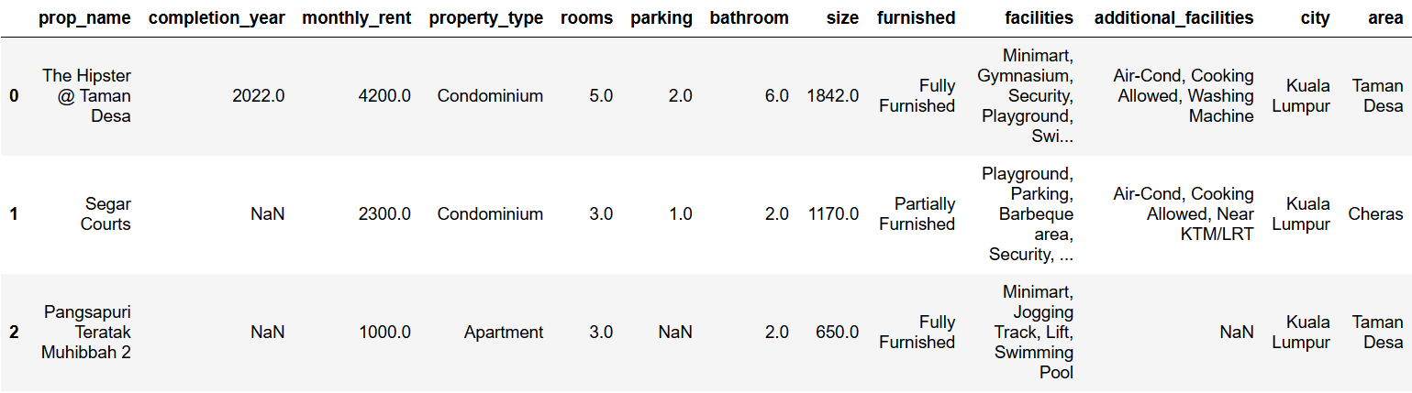
The fitst 3 data of our dataset in malaysia_house_rental_price_data.csv is as follows:
Overview of our Dataset
Features:
Target feature:
Property name, Completion year, Property type, Rooms, Bathrooms, Parking slots, Size of property, Furnished condition, Facilities and Additional Facilities available, City, Area
Monthly rent

Slide 15
Issues in our dataset
Issues in our dataset
Repetitive Information |  | Overlapping data in facilities and additional_facilities because they have been cumulatively entered as strings
Blank Cells |  | Numerous instances of missing values throughout the dataset.
Inconsistent City Names |  | Kuala Lumpur and Selangor have unwanted spaces in the entry names.
Not-referable monthly-rent and size Information |  | Some data seems unreliable. i.e., “rent: RM240000 in Sunway Vivaldi” and “size: 1 sqft in Kelana Sentral”.
Inconsistent data types |  | Some columns have suboptimal datatype. i.e., year (float64).

Slide 16

Post data cleaning
1
2
3
Objectives
Merged facilities & additional_facilities
Cleared observations with missing values
Corrected format of city names
No outliers
No missing data
Fix structural errors.
Remove duplicate data
4
5
Converted all variables to desired datatypes
Took 95% confidence interval of required data

Slide 17
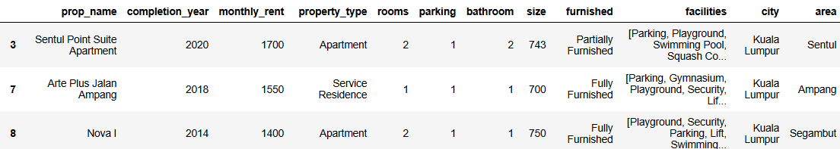
Thus, we end up with:
Post data cleaning

Slide 18
overview
1
Background
2
Research questions
3
Data pre-processing
4
Section 3:
Data Preprocessing
Exploratory Data Analysis
5
Evaluation & Modelling
6
Discussion
7
Conclusion

Slide 19
overview
1
Background
2
Research questions
3
Data pre-processing
4
Section 4:
Exploratory data analysis
Exploratory Data Analysis
5
Evaluation & Modelling
6
Discussion
7
Conclusion

Slide 20
Section 4:
Exploratory data analysis

Slide 21
Investigable Factors
01
02
03
Facilities
City & Area
completion year

Slide 22
Investigable Factors
01
completion year

Slide 23
completion year
The monthly rental remains in a normal increasing rate after year 2014.
The monthly rent is noticeably higher in recent years after 2022
The monthly rental slowly increases until year 2011
The monthly rental hits another relatively low peak in 2014
The monthly rental decrease drastically from year 1999 to year 2001.
Completion year from 1991 and 1994 had a relatively high rental

Slide 24
completion year
Asian Financial Crisis
Oil Price Crisis
Post-pandemic inflation
01
2003-2012
2016 - 2021
1991 - 1994
completion year
The success of New Economy Policy by the National Development Policy (NDP)
1998 - 2001
Country's economy slow recovery from the financial crisis
2014
Rental increases along with the inflation rate
2022-
(Chan et al., 2018)

Slide 25
Investigable Factors
02
Facilities

Slide 26
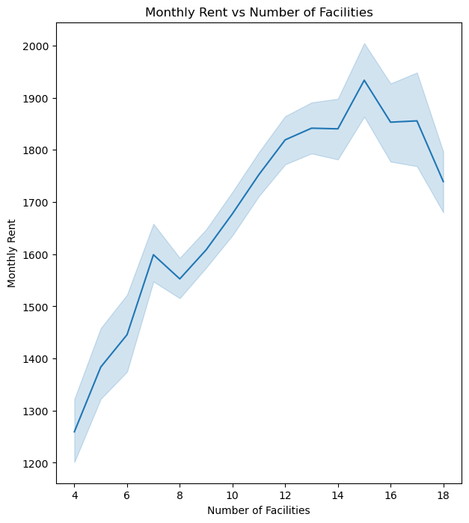
facilities
Observations
General situation of monthly rent for rentals with:
Up to 15 facilities : Generally increases
More than 15 facilities : Generally decreases
Why?
Similarities of rentals despite having >15 facilities:
At far ends of public transport lines (Cyberjaya, Gombak)
Located far away from high-paying job opportunities
Located far away from most educational institutes, recreational outlets, and malls
So, the demand for housing is low in those areas.

Slide 27
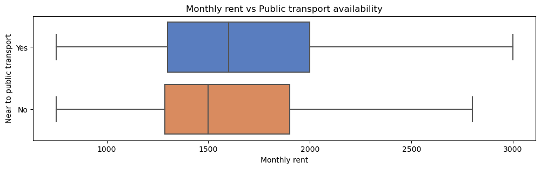
rent vs public transport availability
02
Facilities
Observations
Why?
The demand is higher, because of:
Convenience
Better accessibility
Renters will not need to spend on personal vehicles
Reduce carbon footprint (eco-friendly)
The overall monthly rent is higher for units that have proximity to public transport (KTM/LRT).

Slide 28
Investigable Factors
03
City & Area

Slide 29
City & Area
Kuala Lumpur
City
Selangor
05
1000
1500
2000
2500
3000
3500
4000
Monthly Rent
City
What we see
Why is it so?
In overall, the monthly rent is higher in Kuala Lumpur than Selangor.
Kuala Lumpur is the economic centre of Malaysia, which consist of numerous high consumption area.

Slide 30
City & Area
Observation
All top 10 areas are mostly from Kuala Lumpur.
All bottom 10 areas are mostly from Selangor.

Slide 31
City & Area
Further Approach
We extend our investigation by using service from Nominatim , which is a geolocator module from geopy .
What are we collecting?
Longitude
Latitude
Lastly, we build a heatmap based on the monthly rent.

Slide 32
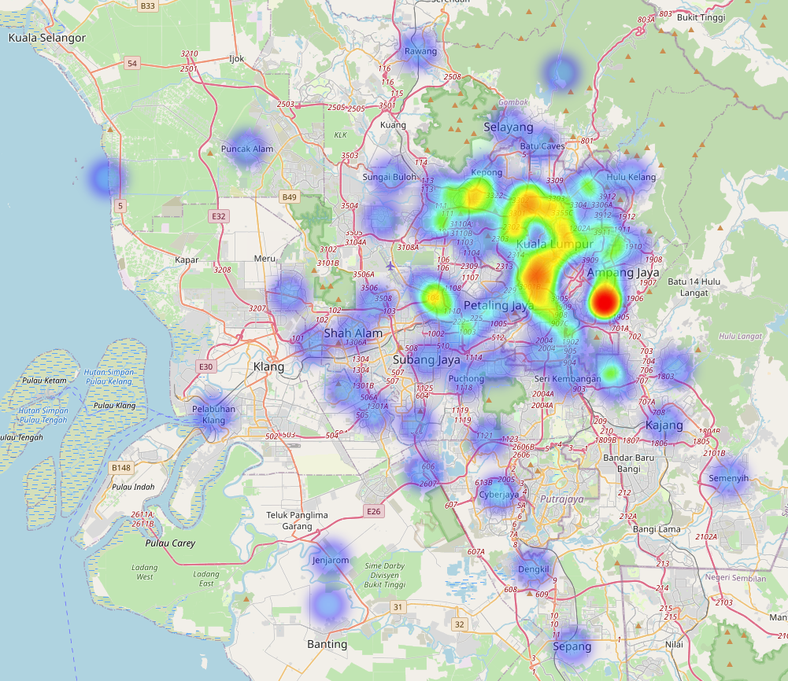

City & Area
What we see
We see that there is not just one cluster, but numerous ones, showing yellow or red (indicating high rental prices).
Why is it so?
This shows that the existence of a city (urbanisation) can bring an increase in rental prices and affect the areas near them, based on the distance.
For clearer pic:
https://sites.google.com/student.monash.edu/preview-of-heatmap-hrp-area/home?pli=1&authuser=2
Low (RM700)
High (RM4000)

Slide 33
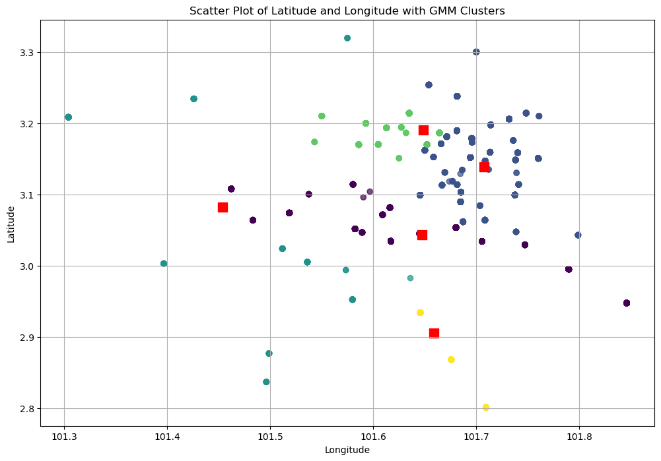
City & Area: Gaussian Mixture model
We made a Gaussian Mixture Model since clusters exist.
Why Gaussian Mixture Model?
GMM can handle complex data distributions.
GMM allows soft clustering, which a data point can belong to multiple clusters.
Kuala Lumpur
Kuala Lumpur
Bandar Klang
Subang Jaya
Approach
We set clusters of 5 and find each of the centres. Then, we calculated distance of every point to each centres in clusters.
Sepang

Slide 34
overview
1
Background
2
Research questions
3
Data pre-processing
4
Section 4:
Exploratory data analysis
Exploratory Data Analysis
5
Evaluation & Modelling
6
Discussion
7
Conclusion

Slide 35
overview
1
Background
2
Research questions
3
Data pre-processing
4
Section 5:
Evaluating & Modelling
Exploratory Data Analysis
5
Evaluation & Modelling
6
Discussion
7
Conclusion

Slide 36
Section 5:
Evaluating & Modelling

Slide 37
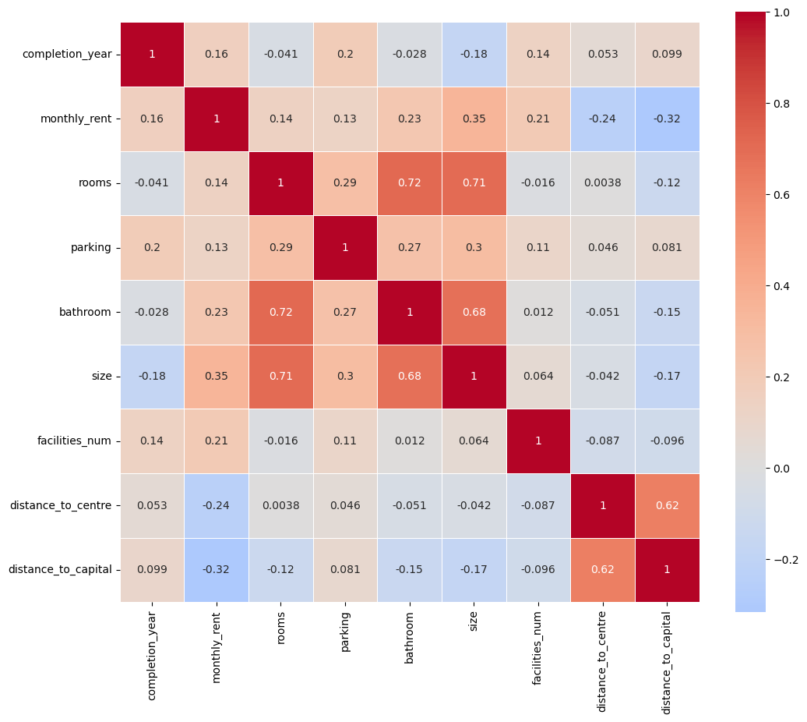
Data correlation at a Glance
What we see
Evaluating the Pearson Correlation in heatmap, we see that each factor are weakly related as there are multiple factors that brings effect to the monthly rent.
Approach
We require at least 2 models consist of:
Multiple Linear Regression Model
Polynomial Regression Model

Slide 38
Modelling
Approach for every model
70
30
AND
We separated current data into:
%
training set
%
testing set
We have built a Multiple Linear Regression Model.
Multiple Linear Regression Model: Best fit hyperplane
$$E\left(X\right)= 20.91x_{1} −170x_{2} −14.63x_{3} +122.71x_{4} +1.24x_{5} +21.40x_{6} −19.57x_{7} −41431.6$$
where:
x₁: completion year
x₂ : rooms
x₃ : parking
x₄ : bathroom
x₅ : size
x₆ : facilities num
x₇ : distance to centre
E(X): expected monthly rent for that specific type of room
Testing score: 0.266
Testing score: 0.263

Slide 39
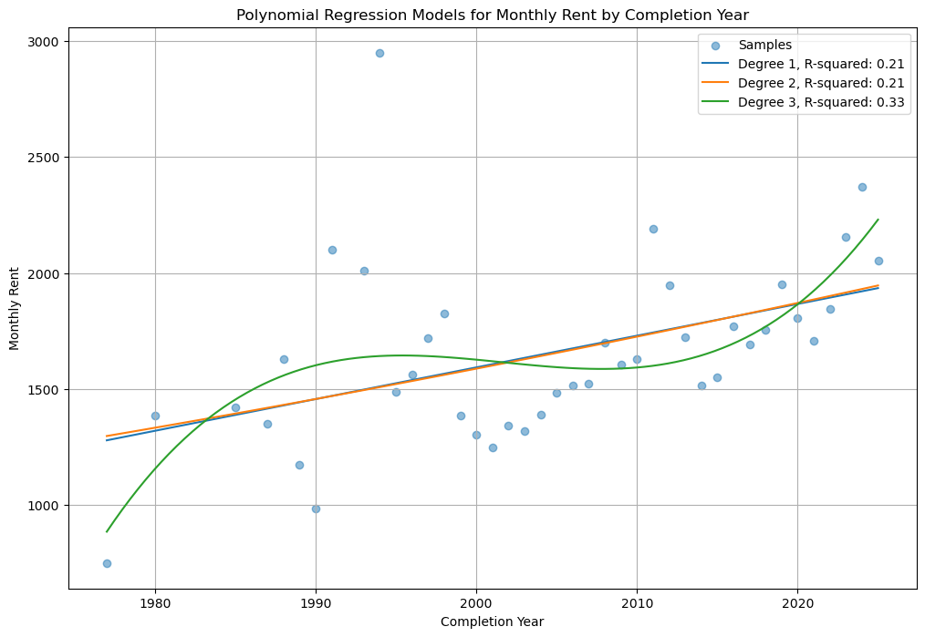
Polynomial regression model of monthly rent and completion year
To predict the future trend, we built a Polynomial Regression Model by taking mean for each year.
Degree 1 equation:
13.91𝑥 −2.631×10⁴
Degree 2 equation:
0.5528𝑥² −2209𝑥 +2.207×10⁶
Degree 3 equation:
0.0607𝑥³ −364.58𝑥² +7.3×10⁵𝑥 −4.9×10⁸
R-squared value
Degree 1: 0.21
Degree 2: 0.21
Degree 3: 0.33

Slide 40
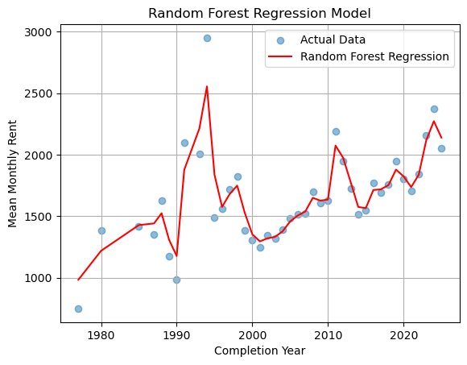
Random forest regressor model of monthly rent and completion year
This predictive model uses a combination of mean and decisions from tress or previous data (years) to predict the future data, where the final prediction is the average of all other previous predictions.
R-squared value: 0.8978
This model overfitted.
The is because a random forest regressor model uses average method to improve the predictive model's accuracy
This is coherent with the grouping of monthly rent by completion year using the mean.

Slide 41
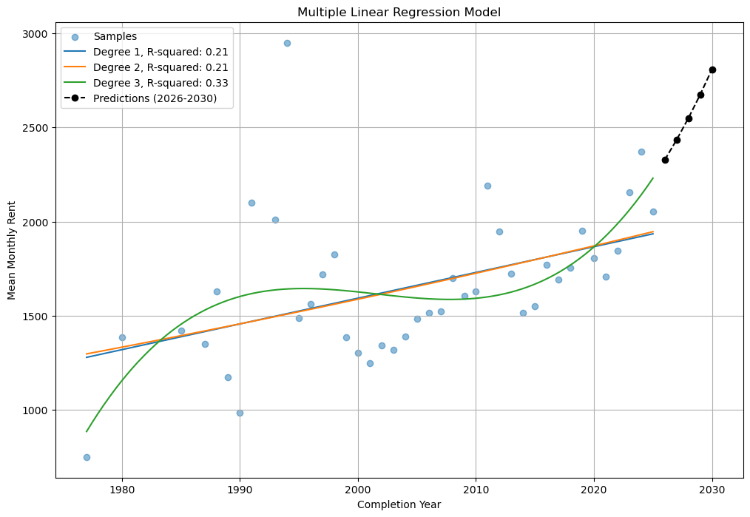
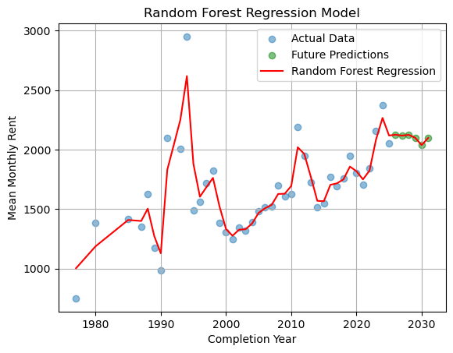
Random forest regressor model vs POLYNOMIAL regression model
Which model to use? This depends on the prediction of future monthly rents.
Polynomial Regression Model (power 3)
2026:$2327.11
2027:$2433.12
2028:$2548.39
2029:$2673.28
Polynomial regression model always shows an upward trend
We only see increasing trend in this model
Random Forest Regressor Model
2026:$2192.27
2027:$2142.86
2028:$2256.07
2029:$2144.28
Random forest regressor model makes decision based on previous trends
We see a decreasing trend following by increasing trend in this model

Slide 42
overview
1
Background
2
Research questions
3
Data pre-processing
4
Section 5:
Evaluating & Modelling
Exploratory Data Analysis
5
Evaluation & Modelling
6
Discussion
7
Conclusion

Slide 43
overview
1
Background
2
Research questions
3
Data pre-processing
Section 6:
Discussion
4
Exploratory Data Analysis
5
Evaluation & Modelling
6
Discussion
7
Conclusion

Slide 44
Section 6: Discussion
Recalling back questions from Section 2:
01
What are the significant factors influences the rent for the property?
02
How to predict the movement of rental in future years based on previous trends?
03
How to find the most suitable rental area (or property name, type etc.) to be invested, or rented?
04
For property developers, where to potentially build a new housing area?

Slide 45
Section 6: Discussion
01
What are the significant factors influences the rent for the property?
In this project, based on the result of f-test from multiple linear regression model, we found out the significant factors:
02
How to predict the movement of rental in future years based on previous trends?
Completion_year
Rooms
Parking
Bathroom
Size
Facilities_num (Number of facilities)
Distance_to_centre (Distance of property to the centre of each urban)

Slide 46
Section 6: Discussion
02
How to predict the movement of rental in future years based on previous trends?
We could put some input to the regression equation, that could give the overall evaluation on how would the rental fee goes in the future.
The regression equation:
03
How to find the most suitable rental area (or property name, type etc.) to be invested, or rented?
For example:
In the year of 2026, the estimated mean room price would be:
ŷ = RM 2327.11
compare to mean room price when 2021 which is RM 1705.44

Slide 47
For rental, the specific requirement could be inserted to the equation, and it could present a tenant either the locus, that is available, or the rental price (if specified the location) The equation of hyperplane based on all the 7 significant factors that affect the rent:
Section 6: Discussion
03
How to find the most suitable rental area (or property name, type etc.) to be invested, or rented?
$$E\left(X\right)= 20.91x_{1} −170x_{2} −14.63x_{3} +122.71x_{4} +1.24x_{5} +21.40x_{6} −19.57x_{7} −41431.6$$
For example:
Unit that is built in 2021 with 1 room, 1 parking, 1 bathroom, with a size of 400 sqft, 3 facilities, with distance to the centre of 3km brings:
E(X) = RM 1267.08
04
For property developers, where to potentially build a new housing area?

Slide 48
Section 6: Discussion
04
For property developers, where to potentially build a new housing area?
Based on a heatmap created when analysing Rent vs City, property developers is suggested to build a new property at the yellow and green areas because these are the areas that have potential to give back a high return of investment (ROI).

Slide 49
overview
1
Background
2
Research questions
3
Data pre-processing
4
Section 6:
Discussion
Exploratory Data Analysis
5
Evaluation & Modelling
6
Discussion
7
Conclusion

Slide 50
overview
1
Background
2
Research questions
3
Data pre-processing
4
Section 7:
cONCLUSION
Exploratory Data Analysis
5
Evaluation & Modelling
6
Discussion
7
Conclusion

Slide 51



Section 7: conclusion
In this study, we had done…
Analysis
Modelling
Visualisation
There are mainly 7 crucial factors that impact rental prices which provide insights into market dynamics.
We made 3 models namely multiple linear regression model, polynomial regression model and random forest regression model for prediction.
Visualised all results and model in the form including heatmap, boxplot, histogram and so on.

Slide 52
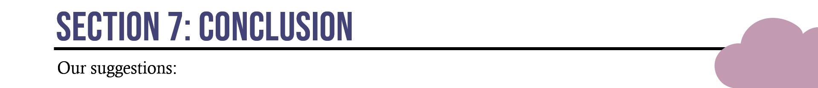

Section 7: conclusion
Our suggestions:
Tenants
Investors
Developers
Tenants should always consider the various factors that affects the rental to find a most suitable rent that suits themselves the best.
Investors should keep an eye on the events that will make rental price fluctuates before investing a property.
Property developers should focus on potential area to build a property by monitoring different areas based on the different aspects.
This has proved the importance of predictive models in understanding and forecasting rental market dynamics in the real estate sector.
Notes:
Property developers should focus on areas that will benefit the most from building a house there, things to consider: MRT/LRT, closeness to city and so on.

Slide 53
Danke !

Slide 54
References
‌Chan, K. H., Ho, G. Y., Lim, F. Y., Lim, M. Y., & Yap, Y. L. (2018). Determinants of housing price index in Malaysia (Doctoral dissertation, UTAR).
Worldometer. (2023). Malaysia Population. https://www.worldometers.info/world-population/malaysia-population/
Zainon, N., Mohd-Rahim, F. A., Sulaiman, S., Abd-Karim, S. B., & Hamzah, A. (2017). Factors affecting the demand of affordable housing among the middle- income groups in Klang Valley Malaysia. Journal of Design and Built Environment, 1-10. https://doi.org/10.22452/jdbe.sp2017no1.1

